Slide 1

DEA Update: Initiatives to Improve CWA Permitting
Efficiency
Daniel R Peake
Assistant Director
DEA

Slide 2

In-house initiatives
Notifications of ROW plans to central office
Notification of Changes to ROW plans
Attempt to get permitting moving sooner in project development process without putting the….

Slide 3


Funding Positions at KDOW and USACOE
1 Position at KDOW
3 Positions at USCOE

Slide 4

DECISION MAKING PROCESS
Receive permits quicker
Can set their priorities
Only work w/Louisville*
More consistent regulating
Fewer personalities to work with
Personnel dependent
Ability to track performance
Cost
Personnel dependent
Bad
Good

Slide 5
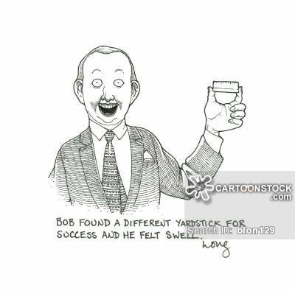
Performance measure Examples
Field visit date (within 2 weeks of submittal)
Request for additional information (time limit)
Total days between complete application submittal and agency notice
Agency notice date to final action
Total days between submittal and final action

Slide 6
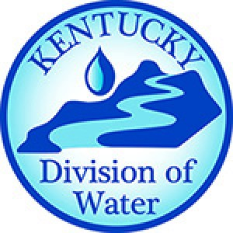
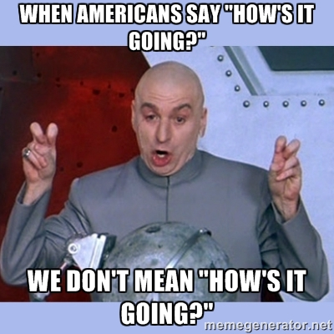
It took a few months to put the contract together
Personnel dependent – KYTC does have right to provide input on personnel decisions
Position has been filled since Dec 1, 2015
Growing Pains
Performance Measures

Slide 7


It took a YEAR to put contract together
Personnel dependent – KYTC does not have the right to review applicants however…
Initiated in May 2016
Only 2 of 3 positions currently filled, 1 is on re-assignment to
Growing Pains
Performance Measures

Slide 8
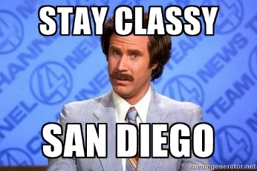
It took a YEAR to put contract together
Personnel dependent – KYTC does not have the right to review applicants however…
Initiated in May 2016
Only 2 of 3 positions currently filled, 1 is on re-assignment to
Growing Pains
Performance Measures

Slide 9


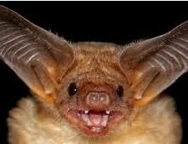
Other Accomplishments:
LOP for WQC
Working On:
Section 106 Agreement with the USACOE and State Funded Projects
Next up: BATS

Slide 10
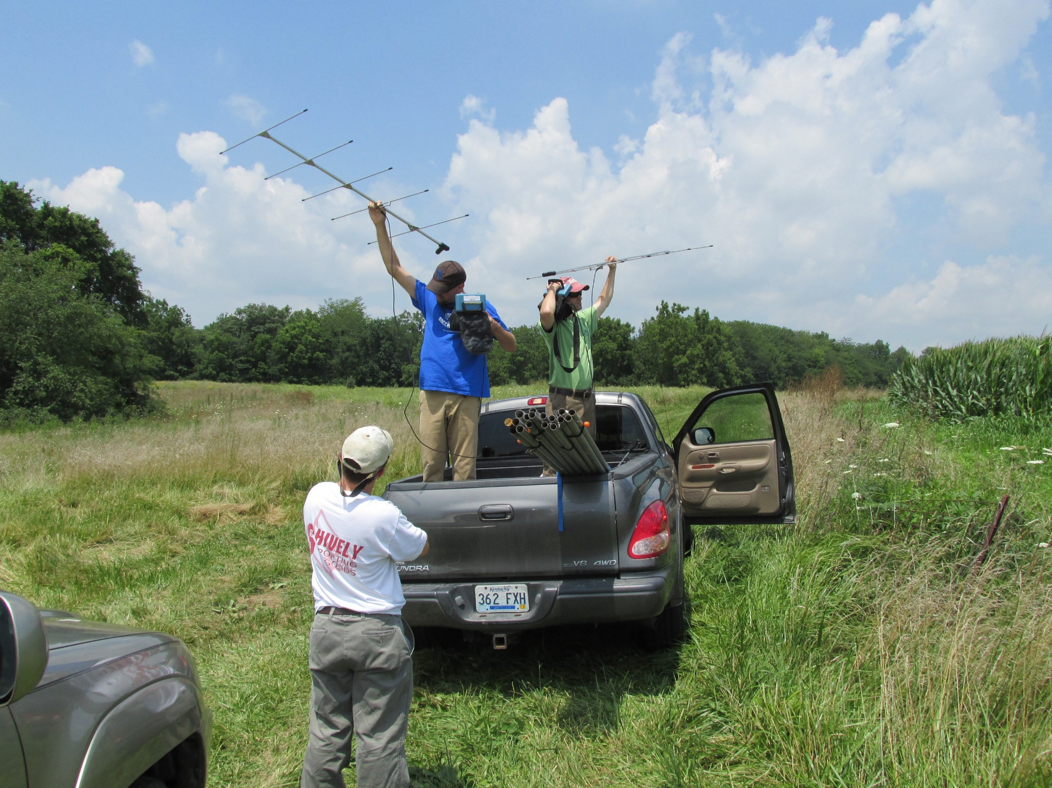
BATS
WHAT NOW !?!
Richard Clausen
Redwing Ecological Services, Inc.

Slide 11
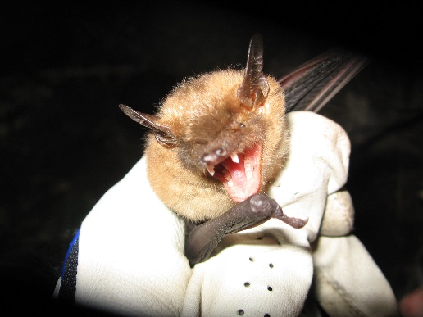
STREAMLINING AGREEMENT TIMELINE
2015 - Conservation Strategy for Forest Dwelling Bats
2006 – Indiana Bat Programmatic Agreement
2012 – Indiana Bat Programmatic Agreement
2016 - 4(d) Rule for Northern Long-eared Bat
2006 – White Nose Syndrome in New York
2015 – Northern Long-eared Bat Listed
2015 – Range-wide Biological Opinion
More Species Listed??
80% decline in bat population
in the Northeast

Slide 12
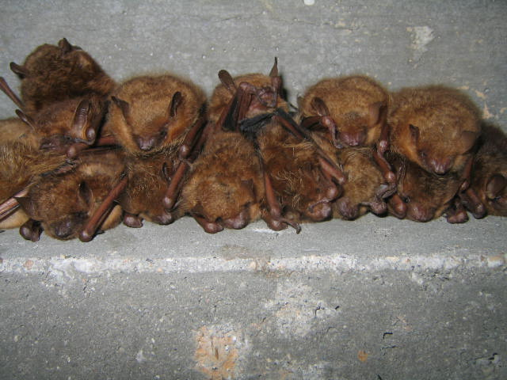
CONSERVATION STRATEGY FOR FOREST-DWELLING BAT
APRIL 2015
GOOD:
BAD:
SPECIFICS:
Addresses both Indiana bat and northern long-eared bat
Covers a broad range of projects
Will ALWAYS involve a “Contribution” to the Imperiled Bat Conservation Fund (IBCF)
Project specific evaluation for:
  Clearing greater than 100 acres of habitat
  Clearing between June 1 and July 31
  Projects within 1 mile of P1/P2 hibernacula
  Projects within 0.5 mile of P3/P4 hibernacula
“Contribution” amount is location and season dependent

Slide 13
CONSERVATION STRATEGY FOR FOREST-DWELLING BAT

Slide 14
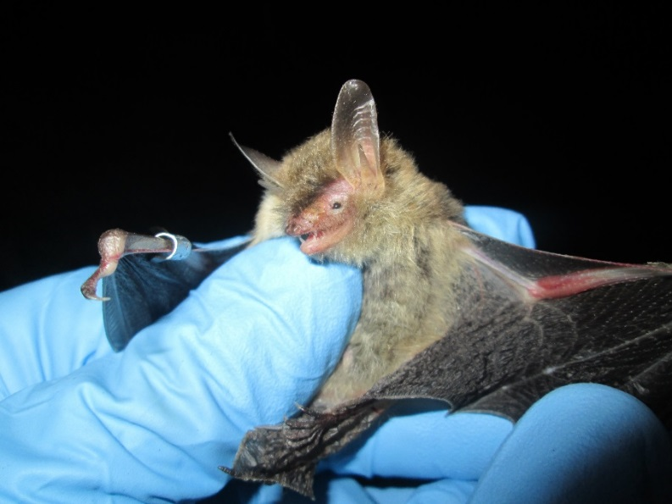
4(d) RULE FOR THE NORTHERN LONG-EARED BAT
JANUARY 2016
GOOD:
BAD:
SPECIFICS:
No seasonal tree clearing restrictions
Covers a broad range of projects
NO MITIGATION PAYMENT!!
Addresses ONLY northern long-eared bat
No acreage limit
No restrictions on the type of project (i.e. federally vs. state funded)
No impacts to known hibernacula
No clearing within 0.25 mile of known hibernacula
No clearing within 150 feet of known maternity roost between June 1 and July 31

Slide 15
4(d) RULE FOR THE NORTHERN LONG-EARED BAT

Slide 16
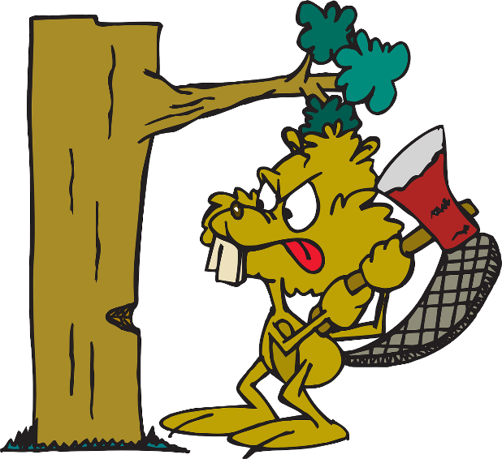
RANGE-WIDE PROGRAMMATIC CONSULTATION FOR INDIANA BAT AND NORTHERN LONG-EARED BAT
UPDATED MAY 2016
GOOD:
BAD:
SPECIFICS:
Addresses both Indiana bat and northern long-eared bat
NO MITIGATION PAYMENT!!
Covers narrow project range
Project MUST be federally-funded
Tree removal allowed if:
  Occurs within 100 feet of the existing road surface, AND
  Occurs within the unoccupied season (November 14 – March 31) , AND
  The clearing area is clearly marked, AND
  Occurs greater than 0.5 mile from known hibernacula, AND
  Occurs greater than 0.25 miles from known roost site
Also specifies restrictions on lighting and bridge/structure maintenance

Slide 17
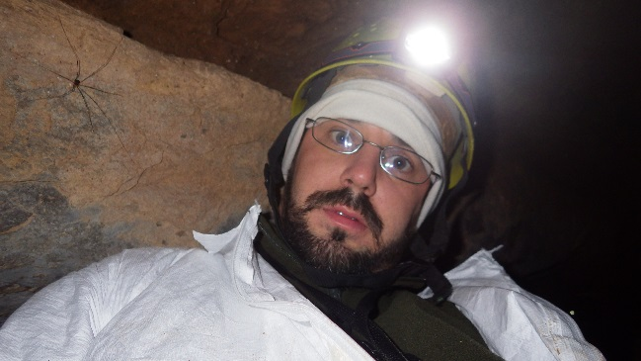
Bats, continued
ANDREW is not worried, see…
Andrew Logsdon
Biologist
DEA

Slide 18
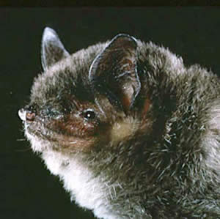
Gray bat
Listed statewide in KY in 2016
  ~45 additional counties
More BA reports -- $$, Time for review
Future:
  Bridge Evaluation Form
  Gray Bat Programmatic
Cave-dwelling
Forages along streams, fields and fence rows

Slide 19
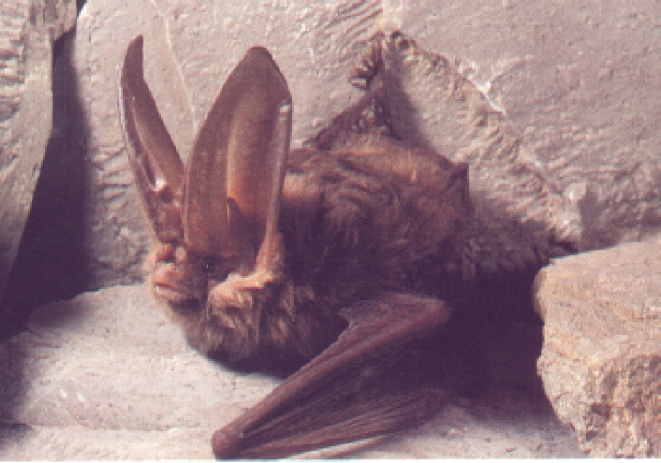
Virginia big-eared bat
KY County Record Listings:
  Bath Menifee
  Carter Morgan
  Elliott Owsley
  Estill Powell
  Jackson Pulaski
  Laurel Rockcastle
  Lee Rowan
  McCreary Wayne
  Madison Whitley
  Wolfe
Cave-dwelling and rock shelter use
Forages numerous landscape types

Slide 20
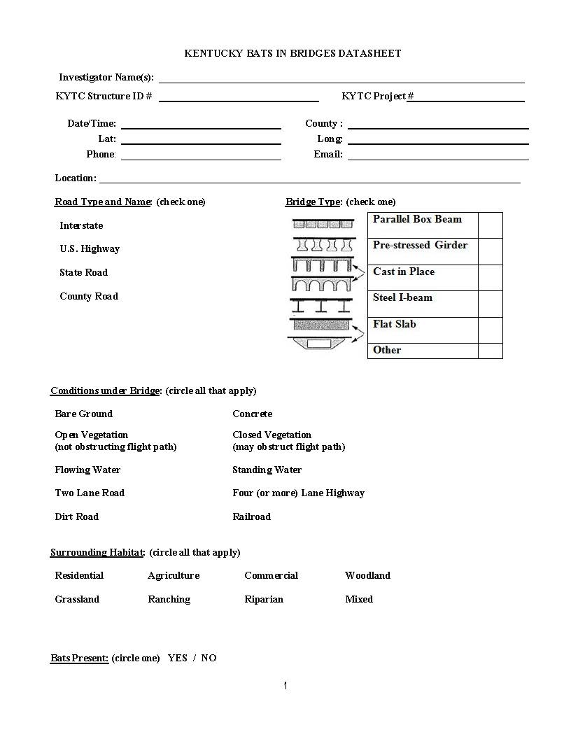
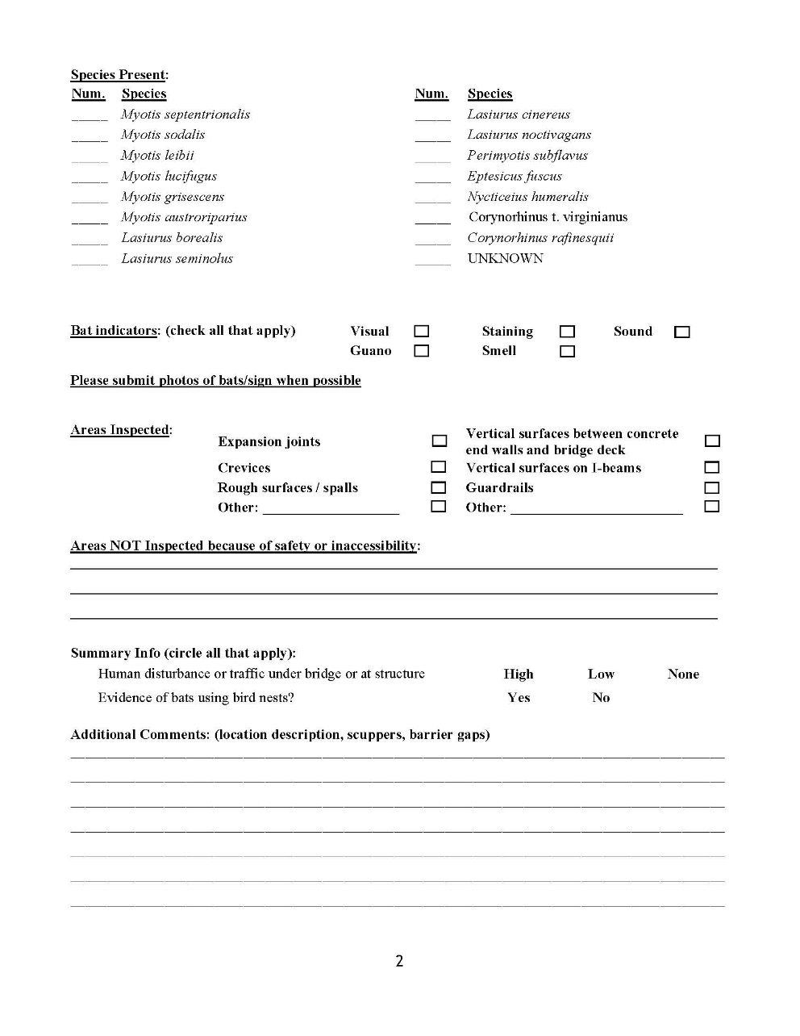
BATS & BRIDGES

Slide 21
Winter Habitat
USFWS requires that we search within 1km of the project limits to identify any potential winter roosting habitat (mines, caves, sinkholes, etc.)
Small projects don’t always require an extensive search within 1km
Office Assessment: ID areas with potential to have mine portals and/or karst openings
Field assessment: site visit to confirm presence/absence of openings, if found assess the opening for potential to serve as a hibernacula (Phase 1 assessment sheet)
If opening passes as a potential hibernacula then a survey will be required (Fall vs Spring)
Unlike tree-clearing there is no programmatic approach to account for impacts to winter habitat, each project handled individually.

Slide 22
Additional Questions/Initiatives
When is it better to consider survey vs. paying the IBCF?
  KYTC – Consultant Work Group
  Work to be complete before 2017 Sampling Season
How do tree cutting restrictions affect Construction bids?
  Research Project initiated by Kentucky Transportation Center
  Interview Construction Contractors
  Anticipate two year schedule

